Slide 1
Coffee Sales Insights Utilising Excel
By Nishigandha Jadhav
Aspirant Data Analyst

Slide 2
Overview
Coffee, originating in Ethiopia, has a rich history dating back to the 9th century. It has spread globally as a popular beverage for its stimulating effects and social appeal. It gained fame for its unique flavour, caffeine boost, and role in fostering cultural and social interactions, becoming a daily ritual worldwide. Coffee shop sales analysis is vital for understanding customer preferences, optimising inventory, and improving profitability by identifying trends, peak times, and popular products to enhance customer satisfaction and drive business growth.

Slide 3
Objective
How do sales vary by day of the week and hour of the day?
Are there any peak times for sales activity?
What is the sales total revenue for each month?
How do sales vary across different regions?
What is the average price/order per person
Which products are best-selling products in terms of quantity and revenue
How do sales vary by product category and type

Slide 4
Key insights
Total Revenue: The overall earnings generated through the sales
Total Customers: The overall count of customers who have visited a coffee shop.
Peak Time: The time of the day at which sales are high
Average cost: The typical revenue generated from each customer.
Average Order: The typical number of orders placed by each customer.

Slide 5
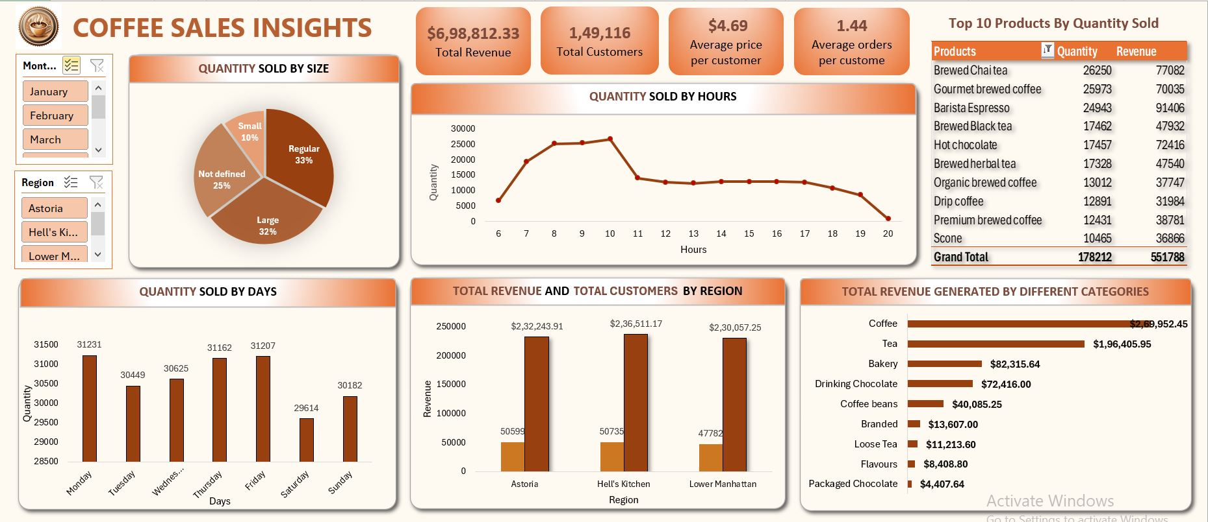

Slide 6
Conclusion
The coffee sales data shows a total revenue of $ 6.98 K from 149,116 customers.
On average, each customer spends $ 4.96, averaging 1.44 orders per customer.
Peak sales occur between 9 AM and 10 AM. Sales decline steadily afternoon, with the lowest activity observed in the evening (after 7 PM)
Brewed chai Tea ranks first with 26,250 units sold. Other popular include Gourmet Brewed Coffee and Brista Espresso.
Monday has the highest sales volume(31,231 units) closely followed by Friday (31,162 units). Saturday experiences the lowest sales(24,614 units)
Hell’s Kitchen generated the highest revenue ($2.26 k)

Slide 7
Reccomendations
Focus on peak times: Allocate more resources (e.g., staff, stock)during peak hours (9-10AM) to maximize efficiency and customer satisfaction.
Regional Strategy: Leverage the success of Hell’s Kitchen by replacing strategies in the other regions

Slide 8
Thanks
Do you have any questions?
nishigandhasjadhav2001@gmail.com
+91 7620882667

Slide 9
Resources
Did you like the resources in this template? Get them on these websites:
Dataset
Maven Analytics - https://www.google.com/url?sa=i&url=https%3A%2F%2Fmavenanalytics.io%2Fproject%2F11565&psig=AOvVaw1w8QIRWJ3KXY5F5i3IOayI&ust=1731777846763000&source=images&cd=vfe&opi=89978449&ved=0CAcQr5oMahcKEwiw9bSt7d6JAxUAAAAAHQAAAAAQBAGuidence
Guidance – Excel Full Project On coffee shop sales by https://www.youtube.com/@wscubetech

